Slide 1

Down the rabbit hole
From Networker to Security Professional
27/03/2020

Slide 2





Hi!
I am Satria Ady Pradana
Cyber Security Consultant at Mitra Integrasi Informatika
Community Leader of Reversing.ID
R&D Member of Indonesia Honeynet Project
Researcher
xathrya
https://xathrya.id
@xathrya
Reversing.ID
Revealing the Truth through Breaking Things

Slide 3
(Cyber) Security Professional
(n) Professional who is hired to keep online information of all sorts protected from cyber attacks and other malevolent threats.
They do:
Utilizing every type of medium to stay on top of technology and security threats.
Going through all the system to check for any type of potential issues.
Putting proper security measures and establishing protocol.
Spreading the word, throughout the company, about security and its importance.

Slide 4
Cyber Security as Alternative Career Path
Expected Challenges in Network Engineering?
Connectivity: topology, routing, segmentation.
Services: web, mail, collaboration, etc.
Resource monitoring and management.
Automation
Security is hot field in Indonesia (especially).
Rapidly growing in demand for qualified people.
Good network engineering enthusiasts have good foundation to enter cyber security field.

Slide 5
Cyber Security Issues in Indonesia
Most activities are Jakarta-centric.
Lack of Security Awareness of Multi Stakeholder (government, private sector, academic, BUMN, etc)
Lack of Professionals.
We need more people.

Slide 6
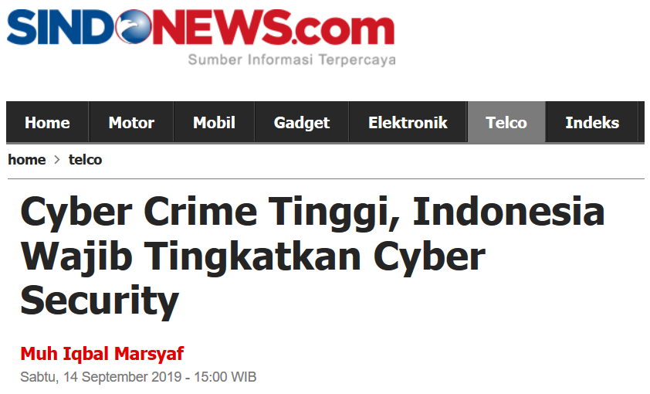

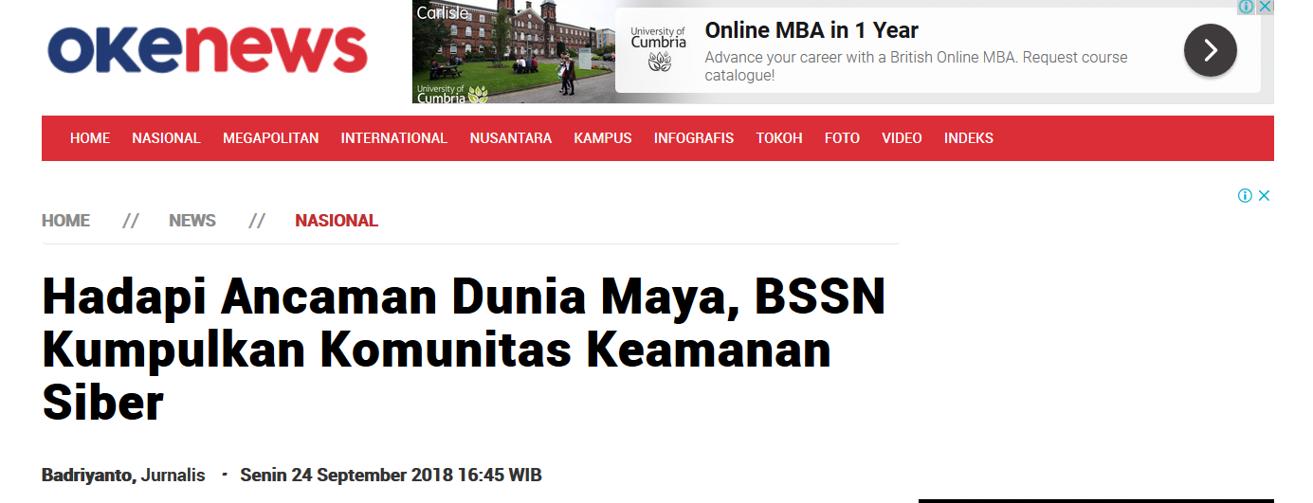
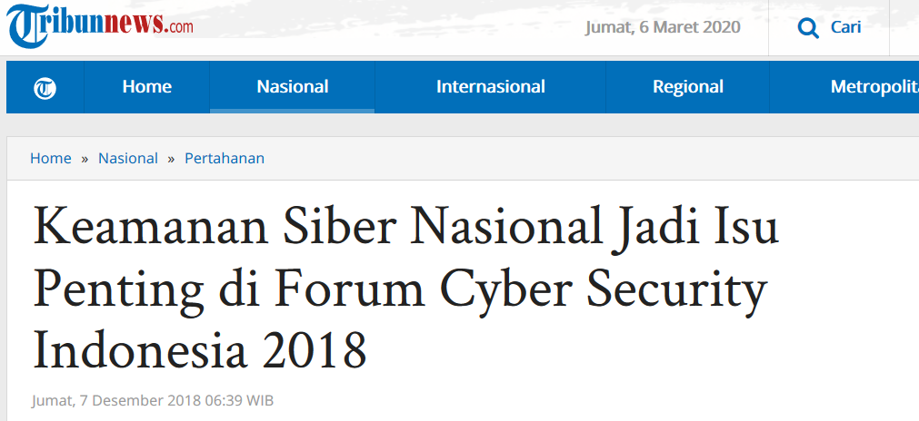
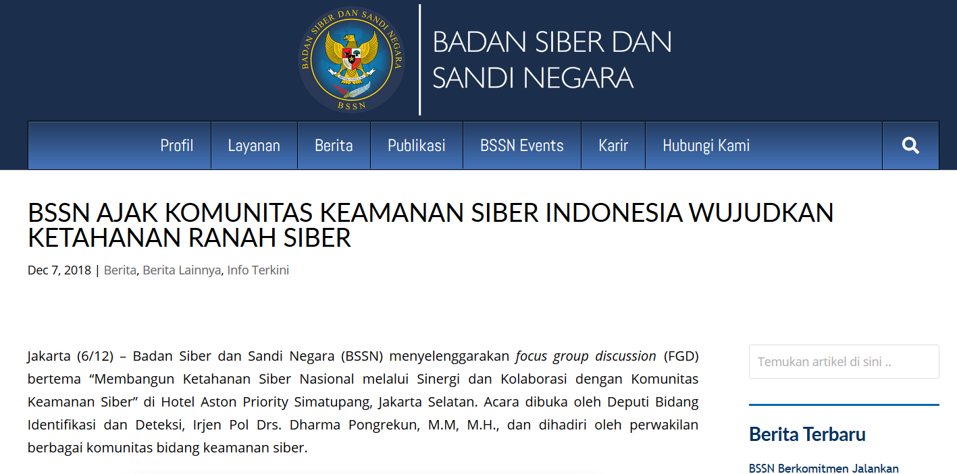

Slide 7
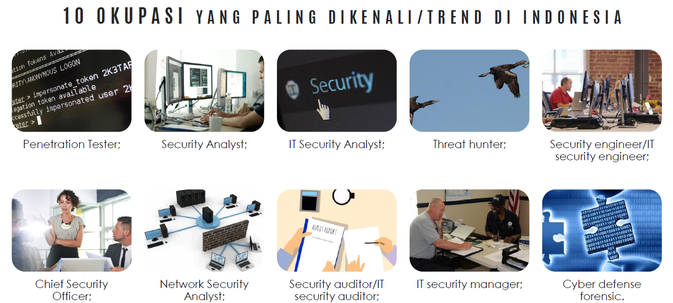
Source : Laporan BSSN Deputi IV Pemantauan dan Pengendalian

Slide 8
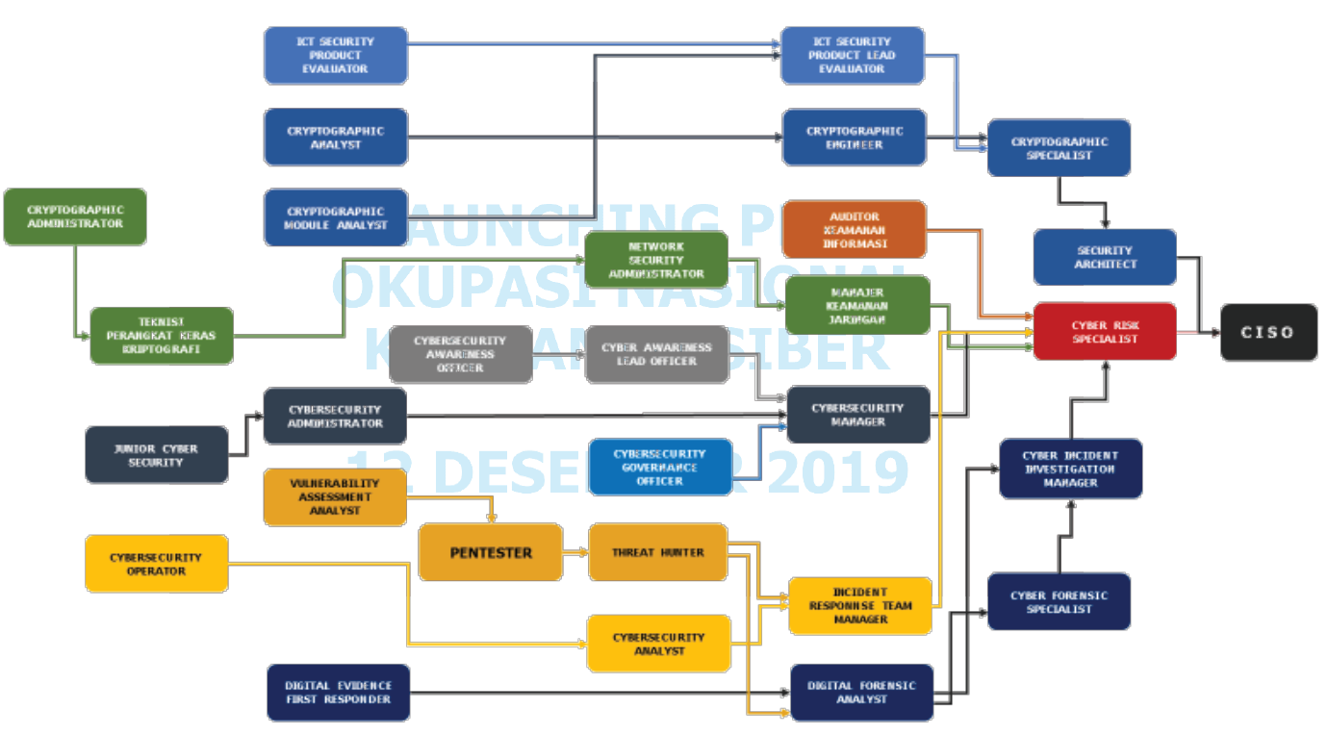
Cyber Security Career

Slide 9


Choose Your Color
Offensive Red Team
Defensive Blue Team

Slide 10
Offensive Red Team
Attack, Exploits, Penetrate Deeper
From Network Enthusiast to Attacker?

Slide 11
Defensive Blue Team
Detect, Deter, Defend
From Network Enthusiast to Defender?

Slide 12
Entering the Arena
Creating Your Own Virtual Lab
Pentest Lab :
VulnHub, DVWA, bWAPP,
Cyber Defense Lab Blue Team
Detection Lab, Blue Team Training Toolkit, APTSimulator
Joining Online CTF Lab and Challenge Yourself
Pentest Lab :
HackTheBox, Pentestit.ru, Attack Defense Lab
Cyber Defense Lab Blue Team
Attack Defense Lab, SANS Forensic Challenge,

Slide 13
References
Red Team : https://www.amanhardikar.com/mindmaps/Practice.html https://medium.com/mii-cybersec/improving-pentesting-skill-with-intentionally-vulnerable-apps-ece1cdf3dc63
Blue Team : https://github.com/pe3zx/my-infosec-awesome#adversary-emulation https://www.amanhardikar.com/mindmaps/Forensics.html

Slide 14
Other than Skills
Join Instant Messaging Community (Telegram / Whatsapp / Slack)
Pentester ID (Telegram)
ECHO (Telegram)
Jasakom Perjuangan (Telegram)
Cyber Army (Telegram)
CDEF (Slack)
IT Audit & Security (Telegram)
Indonesia Honeynet Project (Telegram)
Join the Bug Hunting Platform: Cyber Army, Red Storm, BugCrowd, HackerOne, Synack, dll
Join the Discussion forum or related Facebook Group.
Write and publish research as blog post, paper, article, etc.
Attending Cyber Security Conference, Seminar, Workshop, Training.

Slide 15

QUESTIONS?
xathrya@reversing.id
satria.Pradana@mii.co.id

